Slide 1
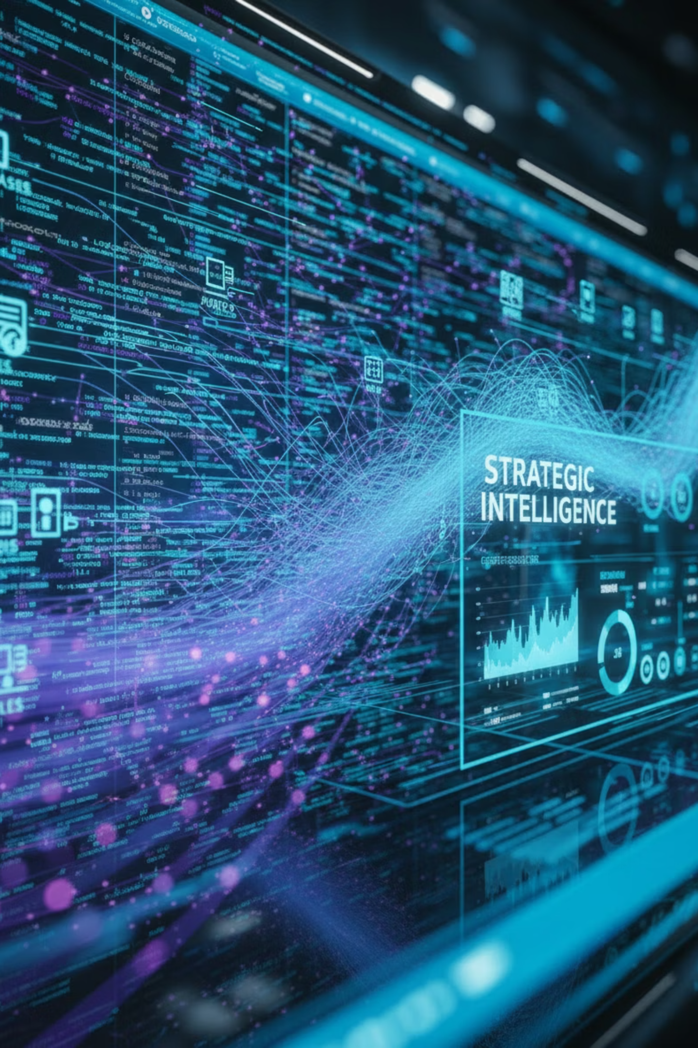
Technical Case Study
Data Explorer
Transforming Data Fragmentation into Strategic Intelligence
A technical case study on building unified data intelligence for enterprise architecture governance at CTO

Slide 2
Background
When I stepped into the role of Lead Architect in our CTO organization, one thing became immediately clear: we were juggling a vast array of applications, each with its own architecture, deployment model, release cadence, and governance needs.
In many ways, finding the answers felt like piecing together a complex mosaic—one where every tile mattered to the bigger picture. I needed to connect the dots fast.
"Without a unified view, decisions were delayed, reporting was inconsistent, and confidence in the accuracy of information suffered."
My role required a comprehensive understanding of each application — where it was hosted (on-premises or in the cloud), how critical it was to business operations, and how resilient its architecture was under pressure. Most importantly, I needed to ensure that every application aligned with our broader technology strategy and governance standards.

Slide 3
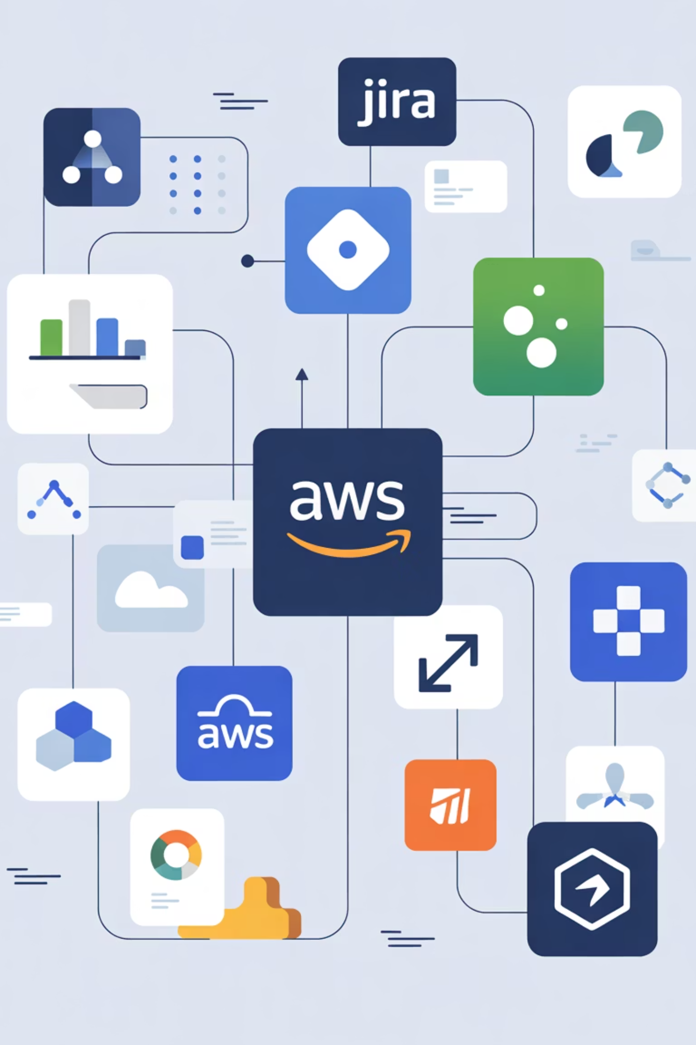
The Challenge: Data Fragmented Across Disparate Systems
The data needed to evaluate applications was scattered across multiple systems — Jira, Service First, LCT, AWS billing reports, and others. Each system told only part of the story, leaving architects to manually connect the dots just to build a complete picture of a single application.
This fragmentation created operational inefficiency and hindered effective governance. Without a unified view, decisions were delayed, some reporting was inconsistent, and confidence in the accuracy of information suffered. Every architect faced the same challenge — constructing a cohesive understanding from disconnected data sources.

Slide 4
The Challenge
Our CTO organization faced significant hurdles due to fragmented data and operational silos, leading to a complex and inefficient environment. This fragmentation manifested in several critical areas:
Inefficient Workflows & Operational Inefficiency
Reduced Productivity & Governance Hindrance
Navigating disparate systems like Jira, Service First, LCT, and AWS billing reports for data collection wastes time and creates cumbersome workflows. This directly leads to operational inefficiency, hindering overall flow and requiring manual collation and interpretation.
The absence of a unified data view from these varied sources significantly impacts team efficiency and output. Crucially, this scattered data hinders effective governance, making it difficult to maintain consistent reporting and strategic oversight across the enterprise.
Decision-Making Delays & Isolated Operations
Increased Training Overheads
Scattered and incomplete information across multiple platforms leads to deferred decisions, errors, and suboptimal outcomes, compromising organizational agility. Furthermore, this fragmentation results in isolated operations, preventing a holistic view of our technology landscape.
The need for teams to master multiple, disconnected platforms adds considerable complexity. This elongates the learning curve for existing staff and reduces onboarding efficiency for new team members, costing valuable time and resources.
To address these critical challenges, I initiated the development of a powerful tool designed to integrate data from diverse sources. Our primary objective is to simplify CTO architect workflows by providing easier, centralized access to data for comprehensive analysis.

Slide 5
The Problem Wasn't Lack of Data—It Was Lack of Integration

Slide 6

Assessment and Insights
Once I understood the scale of the problem, I set out to assess just how deep the fragmentation ran. I began by engaging with architects, Leadership team, delivery leads, and reporting teams across the CTO organization to map out how data was being used — and, more importantly, where it was breaking down.
Discovery Phase
Root Cause Analysis
Mapped data usage patterns across architect teams, identifying pain points and manual workflows that created bottlenecks.
Found that architects operated in isolation, each pulling from different systems and maintaining separate versions of truth.
Impact Quantification
Strategic Realization
Discovered more than 50% of governance time was spent on manual effort — tracking, validating, and reconciling data inconsistencies.
The issue wasn't missing information; it was missing connection. We needed smarter, integrated, reliable data in one place.

Slide 7


Key Insights from Assessment
50%
100%
Time Wasted
Team Impact
Of governance cycles spent on manual data reconciliation
Every architect faced the same challenge connecting dots
The deeper I went, the more I realized the issue wasn't about missing information — it was about missing connection. That realization became the turning point. It was clear we needed a unified, intelligent platform that could bridge our data silos, create a single source of truth, and transform scattered information into actionable insights.

Slide 8
Proposed Solution: Data Explorer
That realization became the turning point. It was clear we needed a unified, intelligent platform that could bridge our data silos, create a single source of truth, and transform scattered information into actionable insights for both technical and business leaders.
To address the fragmentation challenge, I proposed the development of Data Explorer — a unified data intelligence platform built under the CTO organization. Its goal was to create a single source of truth by consolidating key data from Jira, ServiceFirst, LCT, Hypercube, and AWS Billing, Manually collected metrics into a cohesive analytics ecosystem.
By aligning this initiative with the CTO organization's broader data governance and modernization strategy, Data Explorer was envisioned as more than a reporting tool — it was to become the foundation for data-driven decision-making across engineering, architecture, and leadership domains.

Slide 9



Strategic Vision: Three Core Principles
Data Explorer was designed around three interconnected core principles to transform fragmented data into actionable insights:
1. Integration
2. Automation
3. Visualization & Governance
Seamlessly connect and normalize data from diverse enterprise systems through secure REST APIs, forming a unified data model.
Replace manual data gathering with automated ETL pipelines using Dagster, reducing human dependency and improving reliability for data transformation.
Enable real-time insights through Tableau dashboards, improving decision-making speed and accuracy across leadership and architecture teams, supported by robust governance metrics.
Unified data model
Cross-system normalization
Scheduled data ingestion
Interactive dashboards
Real-time synchronization
Automated transformation
Custom reporting
Error handling and recovery
Governance metrics

Slide 10
Proposed Solution Approach
To translate the strategy into action, I designed and led the implementation of Data Explorer, a scalable and secure data intelligence platform that unified fragmented data sources across the CTO landscape. The solution followed a modular, microservices-driven architecture, built for flexibility, automation, and long-term maintainability.
Architecture Design
Data Pipeline
Data Access Layer
Two Python-based microservices — Data Loader and Data API — developed using Flask and FastAPI, deployed on BCP OpenShift for elasticity and high availability.
Dagster orchestration engine automated ingestion, transformation, and validation from multiple sources, stored in S3 Parquet format.
Robust REST API exposed unified datasets to Tableau, governance dashboards, and reporting frameworks.

Slide 11
Proposed Solution Approach continued
Visualization Layer
Security and Compliance
Automation and Deployment
Interactive Tableau dashboards provided real-time visibility into release health, architecture compliance, and governance metrics.
Enterprise-grade controls including BAM authentication, CSM key management, and encrypted data transmission.
CI/CD pipelines via GitLab with SonarQube analysis and Prisma container scanning for robust delivery.
The implementation shifted an intricate, manual workflow into an automated, transparent, and dependable system. Governance cycles experienced substantial time reductions, shifting from days to hours, enabling leadership to make informed decisions based on real-time data with increased confidence.

Slide 12
Technical Architecture Overview
Our solution is built upon a robust architecture designed for efficiency, scalability, and secure data access. It orchestrates complex data flows and delivers insights through an intuitive interface.
Web Application Service
Dagster Data Pipeline Service
Reporting Microservice
Provides a secure web UI, enabling users to interact with data. It exposes both REST API and GraphQL endpoints for flexible data access and integrates seamlessly with Tableau for advanced visualization and reporting capabilities.
At the core of our data processing, this service intelligently orchestrates connections to diverse data sources including MS SQL, REST APIs, SharePoint, Excel, Jira API, and ServiceFirst API. It transforms raw data into refined information and securely stores it in Amazon S3.
This dedicated microservice retrieves processed reports and analytical outputs directly from Amazon S3. It then efficiently serves this critical information to the web application for user consumption and to the broader analytics layer, ensuring timely and accurate data delivery.
This modular and interconnected architecture delivers a highly scalable, automated, and self-serve data ecosystem. It transforms complex data management into a streamlined process, empowering stakeholders with real-time, reliable insights for informed decision-making.

Slide 13
Technical Architecture Overview continued
Complementing this architecture, our robust DevSecOps framework ensures continuous delivery, security, and quality across all microservices:
CI/CD Pipeline Management
Containerization & Deployment
Code Quality & Security Scanning
Utilizes GitLab CI/CD for automated build, test, and deployment of all microservices, ensuring continuous integration and delivery with high velocity.
Leverages Docker for containerization, enabling consistent environments, and OpenShift for scalable and resilient deployment across the infrastructure.
Integrates SonarQube for comprehensive code quality analysis, vulnerability detection, and coverage reporting, along with Prisma Cloud for image vulnerability scanning.
Artifact Management
Continuous DevSecOps Model
Employs Nexus Repository for secure and efficient management of all build artifacts, ensuring version control and integrity throughout the development lifecycle.
Our complete DevSecOps delivery model supports continuous deployment, embedding security practices from inception through operation, automating checks and ensuring compliance.
This modular and interconnected architecture delivers a highly scalable, automated, and self-serve data ecosystem. It transforms complex data management into a streamlined process, empowering stakeholders with real-time, reliable insights for informed decision-making.

Slide 14


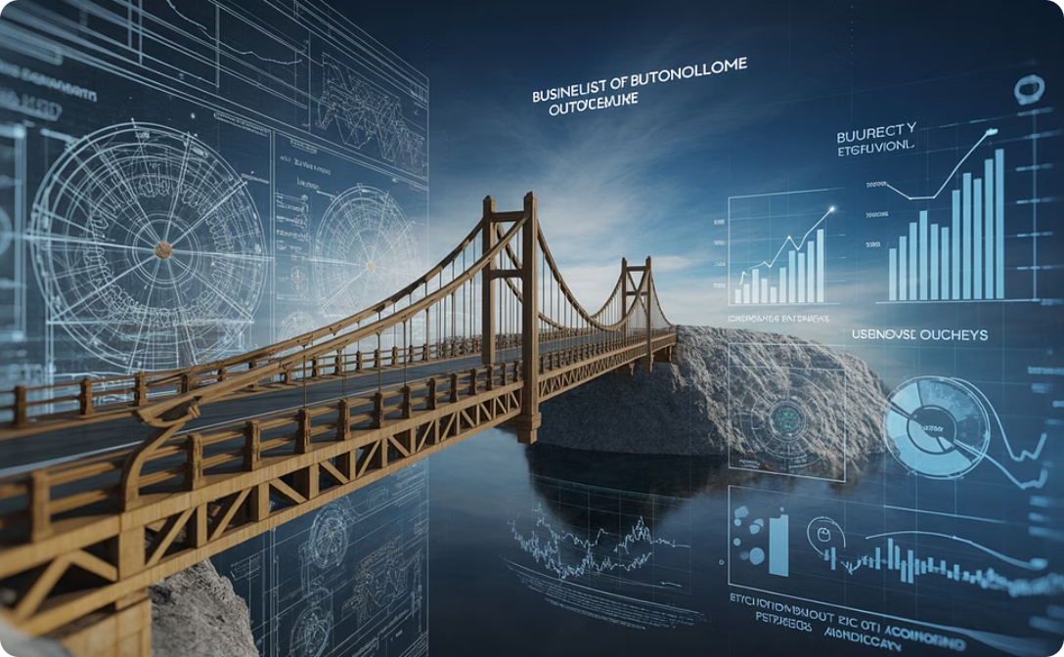
Navigating Complex Stakeholder Landscapes
Multi-Layered Stakeholder Communication
Cross-Functional Coordination & Alignment
Translating Strategy to Business Outcomes
Successfully navigated complex stakeholder dynamics, communicating effectively across various organizational layers. This included lead architects, data source owners, and executive stakeholders such as the CSO, CTO’s Architecture Review Board (ARB), and Cloud Governance teams.
Coordinated continuously with critical teams like GitLab DevSecOps, cloud infrastructure, and security. This ensured continuous alignment on compliance, scalability, and delivery timelines, crucial for project success.
This comprehensive experience strengthened my ability to translate intricate technical strategies into clear, actionable business outcomes. It also honed my skills in building consensus and driving execution across diverse leadership groups.

Slide 15
Data Explorer – Journey & Key Milestones
Discovery & Analysis
Build & Containerization
Secure & Automate
Orchestrate & Deploy
Adoption & Transformation
Data sources identification
Python microservices development
GitLab CI/CD for continuous integration and delivery
Dagster pipelines for data orchestration
Successful production launch
Schema mapping
Business Activity Monitoring (BAM) authentication
Architecture vision
Docker containerization
Data storage in Parquet/S3
Prisma Cloud for image vulnerability scanning
OpenShift integration
Development of Web UI
Driving cultural change towards data-driven decision making
Kerberos authentication setup
Tableau WDC integration for visualization
SonarQube for code quality and security analysis
Nexus for artifact management

Slide 16


Realizing the Data-Driven Future
The successful implementation of Data Explorer has empowered lead architects and senior leadership with seamless access to unified, actionable insights through intuitive Tableau visualizations, streamlining decision-making.
This strategic advancement has cultivated a robust, data-driven culture across the CTO organization, fostering innovation and efficiency at all levels.

Slide 17
Strategic Impact & Outcomes
The launch of Data Explorer marked a turning point for the CTO organization — transforming data governance from a manual, fragmented process into an intelligent, automated capability. Within months of implementation, the impact was evident:
65%
100%
10x
Efficiency Gains
Improved Accuracy
Faster Decisions
Manual reporting time reduced, allowing focus on analysis and strategy
Automated validation eliminated discrepancies across systems
Real-time insights enabled quicker, more informed leadership decisions

Slide 18
Transformational Outcomes
Cultural Shift
Scalable Foundation
The platform fostered a data-driven mindset, encouraging collaboration between technical and business teams and reducing organizational silos.
Modular design allowed rapid integration of new data sources and set the stage for AI-driven analytics and predictive insights.
Data Explorer didn't just solve a technical problem — it redefined how the CTO organization understands and manages its digital ecosystem. It created a culture of transparency, accountability, and continuous improvement.

Slide 19
Force Multiplier: Data Explorer
Data Explorer was envisioned as more than a tool; it was a catalyst for transforming our team into a proactive learning and innovation hub. Through strategic initiatives and focused mentorship, we cultivated an environment of continuous improvement and self-reliance.
01
02
03
Fostering a Learning Culture with "Tech Sync"
Mentorship in Advanced Technologies
Streamlining Development with Reusable Templates
I actively mentored architects on critical technical skills including Python microservices, Dagster, GitLab CI/CD, and OpenShift. This direct guidance significantly accelerated their expertise and capability.
We established "DataExplorer Tech Sync" as a dedicated platform for knowledge sharing and skill enhancement. This initiative was central to fostering a proactive learning culture within the team.
A key outcome was the development of reusable templates, which not only streamlined development processes but also reduced team onboarding time by an impressive 40%. This efficiency gain freed up valuable resources.
04
05
Collaborative Technical Blocker Removal
Empowering Teams for Self-Reliance and Growth
By actively collaborating to identify and remove technical blockers, we cultivated an environment where teams felt empowered to overcome challenges, fostering greater autonomy and problem-solving skills.
The combined effect of these initiatives empowered teams towards greater self-reliance and efficiency. This focus on education and practical tools cultivated shared ownership, transforming repetitive tasks into intelligent automation and enabling a focus on strategy and innovation.

Slide 20
Execution & Delivery: Bringing Data Explorer to Life
The journey of Data Explorer from a complex vision to a powerful reality was marked by strategic execution, rigorous problem-solving, and a commitment to quality. This case study highlights the critical steps and challenges overcome to deliver a robust and empowering solution.
01
02
03
Translating Vision into Action
Navigating Integration Complexities
Streamlining CI/CD & Deployment
The initial phase involved meticulously breaking down the complex vision of Data Explorer into actionable components. This required agile planning and continuous refinement to ensure alignment with strategic objectives, transforming ambitious ideas into a clear, executable roadmap.
A significant challenge was integrating Data Explorer across diverse existing systems. I tackled these integration hurdles by designing flexible APIs and robust data pipelines, ensuring seamless communication and data flow while maintaining system stability and performance.
I resolved critical build and deployment hurdles by implementing and optimizing GitLab CI/CD pipelines. This automated process enforced code quality, accelerated development cycles, and ensured consistent, reliable deployments to various environments.
04
05
Cross-Functional Collaboration & Approvals
Bridging Coordination Gaps & Production Rollout
Effective collaboration with various enterprise teams was crucial for navigating security reviews, compliance approvals, and infrastructure provisioning. By fostering open communication and proactive engagement, we successfully aligned diverse stakeholders and secured timely approvals.
Addressing coordination gaps between development, operations, and business units was key to a smooth rollout. Through established communication channels and clear ownership, we successfully transitioned Data Explorer into production, delivering its full capabilities to end-users and empowering teams with enhanced data insights.

Slide 21
Technical Acumen
At its core, Data Explorer was a deeply technical initiative that required end-to-end engineering expertise — from architecture design to automated delivery and production release. I took end-to-end ownership in developing and implementing the following modules.
Architecture Excellence
Automated Pipeline
Developed microservices-based platform using Python (Flask and FastAPI)
Static code analysis with SonarQube
Container scanning with Prisma
Deployed on OpenShift for scalability and resilience
Automated unit and integration testing
Created Dagster orchestration data pipelinefor complex data workflows
Environment provisioning on OpenShift
Versioned release management
S3-compatible Parquet storage for optimal performance
These automation practices eliminated manual deployment steps, reduced operational errors, and enabled rapid releases — moving features from development to production in hours instead of days.
Enterprise Security
BAM authentication integration
CSM key management
Encrypted data transmission
Compliance with bank standards

Slide 22
Continuous Evolution
The Data Explorer initiative was built upon a commitment to both continuous technical growth and strategic foresight, ensuring it served immediate needs while future-proofing the organization.
Continuous Learning & Growth
Big Picture Thinking
Expanded technical toolkit by mastering new platforms like Dagster for orchestration and integrating advanced CI/CD pipelines (GitLab, SonarQube, Prisma).
Designed Data Explorer with scalability and future adaptability, ensuring deep alignment with the CTO organization's long-term strategic goals.
Transformed every technical challenge, from Docker build failures to dependency conflicts, into a learning opportunity to deepen knowledge and refine best practices.
Consolidated fragmented data to provide senior stakeholders with a holistic view of architecture health, release quality, and operational risk, turning it into actionable intelligence.
Mentored junior engineers on pipeline design, API architecture, and containerization, fostering collective capability and an environment of continuous improvement.
Ensured the platform's modular design could integrate AI-driven insights and predictive analytics, establishing a robust foundation for long-term innovation and enterprise modernization.

Slide 23
Evolving Data Explorer with AI and LLM Capabilities
Building on the success of the current platform, I am now leading the next phase of Data Explorer's evolution — integrating AI and LLM (Large Language Model) technologies to make data exploration more dynamic, intelligent, and interactive.
The goal is to move beyond fixed, predefined reports toward on-demand, AI-driven insights. Using AWS Bedrock for report summarization and LLM-based dynamic report generation, the platform will allow any Lead Architect to generate customized, real-time reports without requiring code changes or developer intervention.
Dynamic Report Generation
AI-Powered Summarization
Interactive Experience
Enabling architects to request and generate tailored reports through natural language queries
Leveraging AWS Bedrock to automatically summarize complex datasets into actionable insights
Creating an adaptive, conversational interface where architects can explore data intuitively and independently
This enhancement is currently in progress as part of our continuous innovation roadmap, transforming Data Explorer from a reporting platform into a self-service, intelligent decision-support system.

Slide 24





Summary
Data Explorer is more than a technical achievement — it's a reflection of leadership, innovation, and strategic alignment.
Leadership
Innovation
Strategic Alignment
Guiding the vision for intelligent data exploration and actionable insights.
Integrating AI and LLM capabilities for dynamic and interactive data reporting.
Ensuring data initiatives support overarching business objectives and growth.
By turning raw data into a trusted strategic asset, Data Explorer continues to shape the future of data governance — enabling smarter decisions, stronger alignment, and sustained innovation across the enterprise.
From Fragmentation to Intelligence
From Manual to Automated
From Isolated to Unified
"From fragmentation to intelligence, from manual to automated, from isolated to unified — Data Explorer represents the transformational power of architectural vision combined with technical execution excellence."

